Slide 1
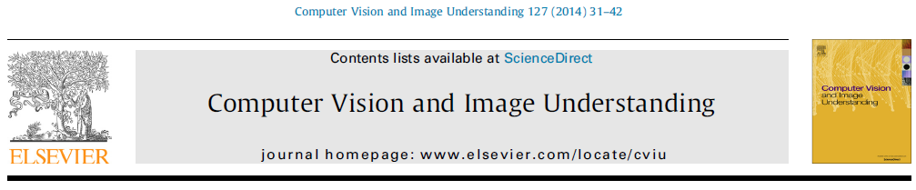
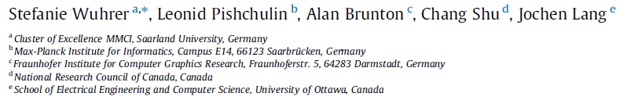
Estimation of human body shape and posture under clothing

Slide 2
This paper present an algorithm to estimate the human body shape and posture under clothing from single or multiple 3D input frames that are corrupted by noise and missing data.

Slide 3
present a representation that models human body shape and posture independently.
Human body shape is represented by a point in a posture-invariant shape space found using machine learning,
and human body posture is epresented using skeletal joint angles.
We present an algorithm to estimate body shape and posture under clothing that fits closely to the body from single or multiple 3D input frames.

Slide 4
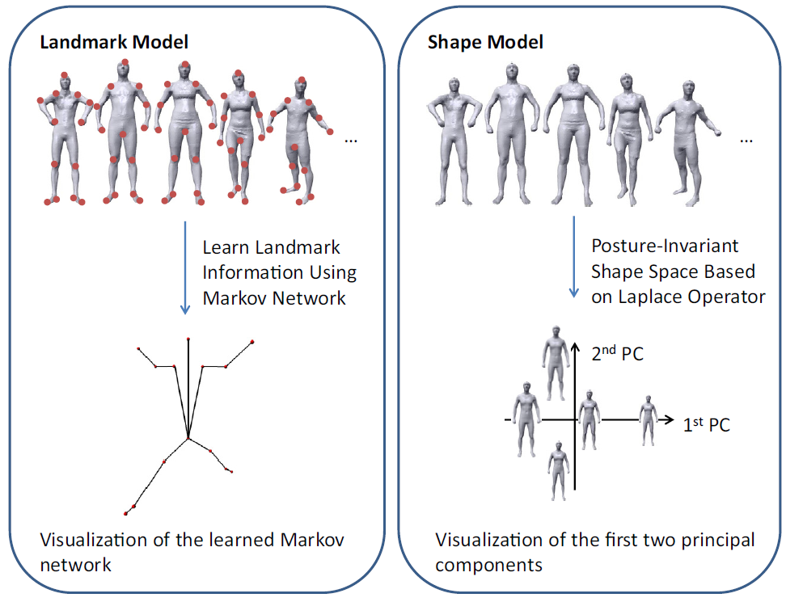
PCA
markov network

Slide 5
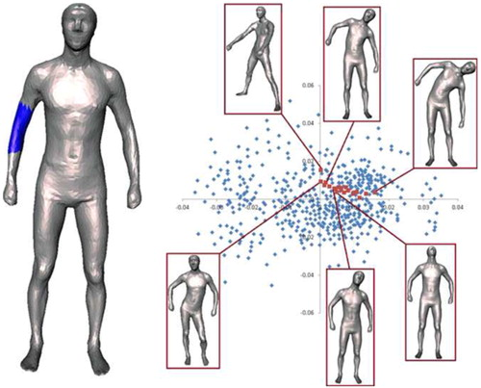
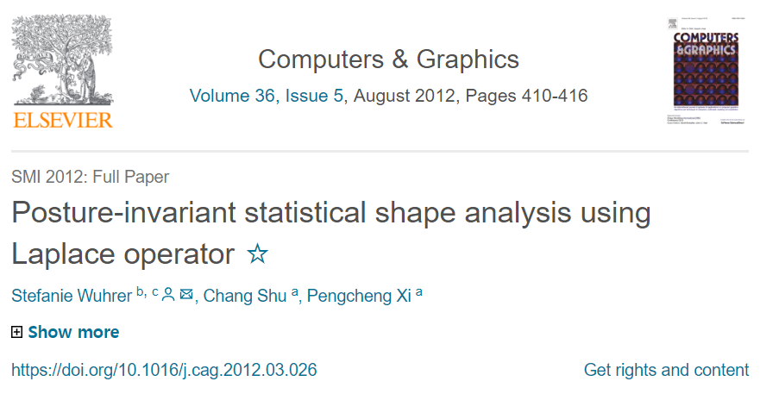
referred paper

Slide 6
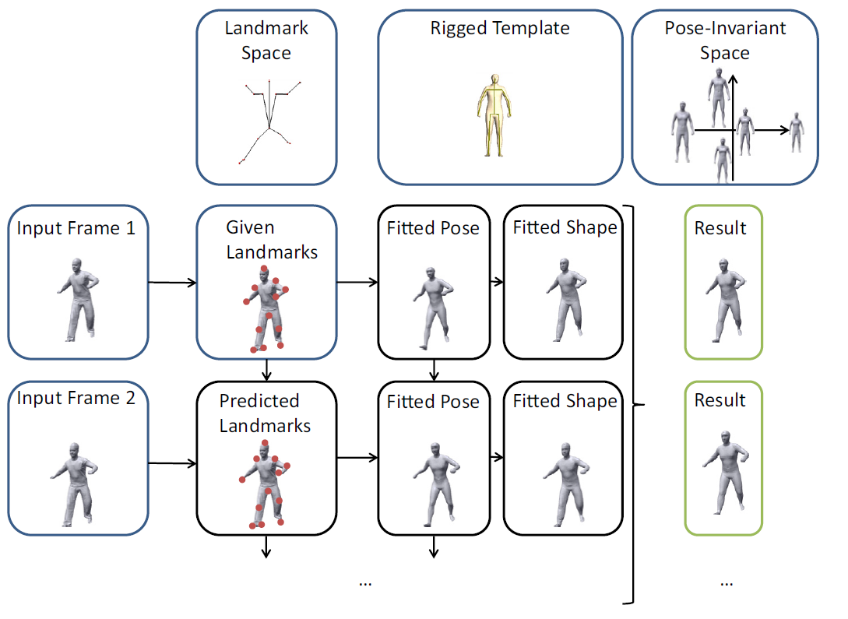
quasi newton approach

Slide 7
